Slide 1
Predictive Model for Insurance Company
Mentored by: Mr. Gunnvant Saini
Presented by: Group 4, IPBA Batch 2
Presenters –
Shubhangi Bansal
Gargi Baser
Pratik Khadse
Neela Madhav Suram
Adeep Bhojne

Slide 2

Overview
Business Problem
Data Wrangling(Munging)
Exploratory Data Analysis
Model Building
Market Basket Analysis
Conclusion
Notes:
-The presentation will be divided amongst these 6 topics, each topic comprehensively explaining the details of our analysis.
-Starting with business problem, what is the task at hand, what do we need to address. Get certain hints about the methodology: classification or regression, etc
-Data understanding: what data is at hand, how much is useful, and how can it be put to use effectively
Exploratory Data analysis and Model building: Finding how the data should be fed to the model, more in depth understanding of the variables or features. How this will impact our model and how we can refine our model
Market Basket Analysis to address some of the client side interactions, giving more clarity to the management team
And finally how we summarize the impact

Slide 3


Business Problem
Client is a leading Insurance Company having long term protection & savings solution plans as their products.
Cost of acquiring new customer > expanding existing customer
Client would like to cross-sell their products to their existing customer base to:
Gain more revenue
Maximize value of customer portfolio
Notes:
-Our business problem revolves around Cross-selling
-Having a long history of business, the company wants to add more value to individual customer portfolio
-customer-centric approach has always been taken by the company
-Cost of acquiring new cust > cost of selling to same customer
-But, the Customer may ‘Not know the range of products available’, given it’s various channels and product portfolios.
-We thus see the two parts to the problem. First: whether additional policy will be bought. Second: If yes, which policy should be recommended (inclined to the customers choices)

Slide 4

Solution
Develop a predictive model:
To identify customers who will
Buy additional policies
Identify the product/s:
What type of policies are those
Customers most likely to purchase
Notes:
-The solution is also two pronged. First we address the classification.
-We use a
-Second we use Market Basket Analysis for the recommending additional policies to the customer
-With this understanding we move ahead from the business understanding part

Slide 5

Data Wrangling (Munging)
Notes:
-Coming to the next part of our analysis, we try to understand what our data is, perform some preliminary analysis and clean it to use further
-This was perhaps a part that took most of time on this project. It was essential in providing insights to the general direction and approach to the business problem
-Consisting of two datasets, and a total of 38 unique variables, We dealt with our data cleaning in 4 steps…

Slide 6

Step 1
Performed Variable Identification to identify
significance of each variable
Step 4
Perform data
cleaning and treatment
Step 2
Compared the two
datasets (Merged
& CustSegList)
Data
Wrangling
(Munging)
Step 3
Create raw data from data chosen in step 2
to identify Target Variable and perform
further analysis
Notes:
-First, we understand the features or variables provided.
-How many continuous variables, How many categorical variables, basic sanity checks
-How does each variable contribute to our additional understanding of the business.
-Second, Then we compare our two datasets,
-identify what was unique to each of these datasets
-Third, we create a raw data
-Deciding what data to keep from both datasets
-Eliminate unneeded variables
-Get derived variables
-Identify target variable
-Finally, perform cleaning nd treating missing values

Slide 7
Step 1: Variable Identification
Identity Variables | Policy related Variables
policy_owner_number | policy_number
Own_gender | premium
LA_gender | afyp
Own_Education | sum_assured
Own_Edu | RCD
LA_DOB | Policy_term
Marital_status | PPT
City | billing_frequency
City_classification | risk_status
STATNAME | contract_type
DSTNAME | Product_description
Focus_Region | Product_Club_Manual
Owner_salary | CUST_prod_cat
Occ_profile | Product_brief_category
Occupation | Par_NonPar
Occupation_group | ECS_flag
own_occupation | channel_flag
Freq (CustSegList) | Med_flag
multi_cust (CustSegList) | Combine_policy (CustSegList)
Notes:
-In step 1, we found that most variables were represented by more than one column
-them having a category: sub-category relation
-This was in regards to not only the insurance related variables: as we can see 3-4 variables for products here (can read some while presenting) but also to customer related variables
-Also, on customer side, data was available non-uniformly, for Proposer as well as ‘person Covered’ (LA: life assured)
-At this initial stage, therefore we found the best classification could be made into
1. Identity Variables (related to customer: either proposer or covered)
2. Policy related variables
-May describe some variables
-We use this as reference while comparing datasets

Slide 8
Step 2: Comparison of Datasets
 | Merged | CustSegList
1. Shape | (812914,37) | (750598,33)
2. Observations | One row per policy purchase | One row per customer
 | Continuous variables related to personal information have same values in both data sets ex- income, age
 | policy_owner_number is unique and identifies the client
 | Variables related to Insurance policies change in CustSegList: 1. sum_assured and afyp are aggregated. 2. PPT, policy term, billing frequency, max of two values is chosen 3. premium, RCD smaller of the values is chosen for majority rows
 | Categorical values remain same across both data sets except for variables with policy description
Outcome: Merged data set is more relevant for further use since aggregate values
present in CustSegList will not be beneficial for predictions
Notes:
-During comparing, we ran some basic sanity checks on both datasets
-checking shape (listed in slide)
-descriptive stats for continuous variables
-value counts and cross tabulations for categorical variables
-Then, find a unique identifier
-policy_number: records given to every policy, used to compare the two datasets
-Finally make a comparison, checking if the value in one dataset for a variable is
-greater than
-equal to
-or less than that present in other dataset
-On closer looks and running some GroupBy functions, we see the noted observations
-All information present in Merged dataset is also in CustSegList
-The CustSegList, was created from the Merged Dataset, with each record assigned to a customer, rather than a policy
-the variable used to identify the customer/client is policy_owner_number
-Identity variables seen before stayed the same
-Policy related information, was consolidated as seen here, choosing either the sum or aggregation, maximum, or minimum of the values
-With this analysis, we decided to move ahead with Merged: which was more suitable due to it’s non aggregated and detailed information

Slide 9
Step 3: Create raw data to do further Analysis
All variables from merged were chosen
Created variable 'age': derived from LA_DOB
Created variable 'Freq': using count of policy_owner_number
Created the 'target' variable:
Count of policy_owner_number (Freq)>1 : 1
Count of policy_owner_number (Freq)=1: 0
Drop columns
Own_Education: abbreviated terms from Own_Edu
own_occupation: abbreviated terms from Occupation
Notes:
Once we choose the dataset, we work with the variables to be included
-Some variables were created, like ‘age’ from one of the identity variables (la_dob: date of birth of life assured. Why? Since we didn’t hv dob of proposer)
-Some are dropped: these are mostly done so, since same data is present in another form (better representation) in another column
-Nd importantly, we also deal with creating our target variable here
-Now that we know unique identifier for customer as well as policies, nd since our focus (atleast part 1) is more related to customer..
-We create a variable frequency identifying number of policies bought by a particular customer
-Then using this as a basis, we create a binary valued variable – target, giving value 1 if freq is >1, or 0 otherwise
-Finally, moving to the last step of Data Wrangling…

Slide 10
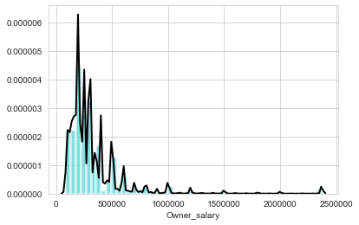
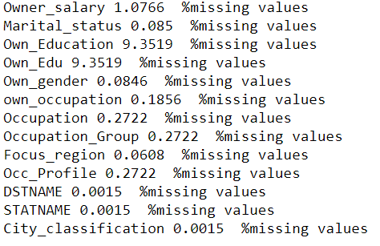
Step 4: Data cleaning and treatment
Cleaning the Data – Cleaning tasks like converting Data Types, converting 'MISSING', 'N.A.' to NaN, String reformatting
Continous Variable
Treating missing values for continuous variables (Owner_salary) by replacing with mean value
Categorical Variable
Dropping rest of missing values (i.e., not treating categorical variables)
Notes:
-Data is cleaned
-string reformatting, convert float values to integers (no need to work with decimals), etc
-Then once correct values and data types are assigned to variables, percentage of missing values is checked
-Noting that only one continuous variable ‘Owner_salary’ representing income of a policy holder, contains missing values, we proceed to treat the same
-SimpleImputer is used to replace these missing vals with the ‘mean’ value
-For the categorical variables, looking at the proportion of missing values, we simply decided to drop them, since it doesn’t affect the data much
-This completes Data Wrangling

Slide 11
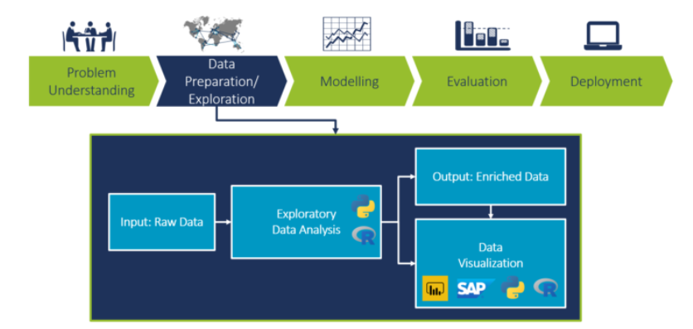
Exploratory Data Analysis (EDA)
Notes:
-While Data munging provided us with a comprehensive understanding of data in relation to the business,
EDA provided an understanding of impact of this data on our target variable and thus the model to be built.
-Assessing this impact in EDA as well as with feature importances in the Model Building part, we first explain the concept of main dataset to be used for our predictive model

Slide 12
Dataset for Model Building: Concept
Customer | Policy Bought
Customer 1 | A
Customer 1 | B
Customer 1 | C
Customer 2 | A
Customer 2 | D
Customer 3 | A
Customer 3 | C
Customer 3 | D
Customer 4 | B
Customer 5 | C
As seen from above example, some of the Customers have bought multiple policies. So we sorted the data as per the 1st policy (based on RCD)
Based on first policy, we predicted Customer buying multiple policies
Notes:
-Suppose we have a customer buying multiple policies
-The first policy that customer 1 bought was A, followed by policy B and C
-Another customer, also buying multiple policies, buys first policy as A, next policy as policy D
-Similarly, we have some more customers, one buying multiple policies and others buying a single policies
-What do we see from this?
-People buying multiple policies always bought policy A first
-Can we hence say, based on the first record of a policy bought, we can predict whether the person will buy additional policy
-Extending this to our dataset, we thus look at all variables associated to the first record of a customers…

Slide 13
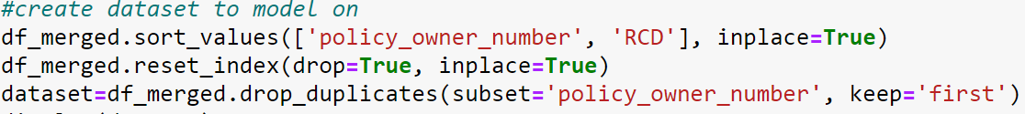
Dataset for Model Building: Execution
Variable RCD (Risk Commencement Date) identified to fetch first policy bought by a customer
Dropping columns not needed for model development
policy_number, policy_owner_number: Identifiers
RCD: sorted already
Freq: Target variable has been obtained
Notes:
-We execute this by using the only datetime feature besides Date of birth, called RCD to isolate relevant record
-RCD will tell us the order in which the policies are bought, nd hence as shown we use it sort policies for every individual customer
-Then we just select the first record.
-We now have a dataset with just one record per customer, with target variable as 1, if the customer has bought multiple policies, 0 otherwise
-To make this dataset ready to be fed to our model, we also drop some variable that shouldn’t be included in a predictive ML model, as listed above
-Now once we have the conceptual part executed, we now move on to the development part of a model, nd things performed in the run up to model fitting
-We plot graphs, to check the impact of different variables on our target variable. This gives us an idea of whether including this variable in the model will add value or not

Slide 14
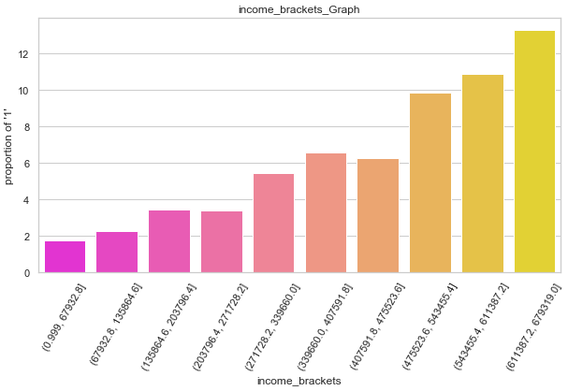
Owner Salary (significant)
Notes:
For eg, here we have a graph of Owner_salary or Income of a particular customer
-Using decile binning of income values on x-axis and percent proportion of target = 1 on y axis, we see that:
- as income increases, people who buy multiple policies increases
-Thus this variable gives us a clear pattern for impact on target variable
-hence can be deemed significant at this stage

Slide 15
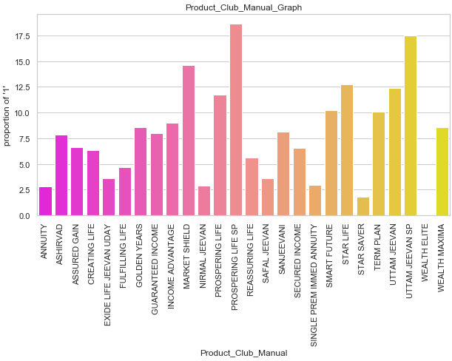
Product Club Manual (significant)
Notes:
-Similarly here we are plotting for a categorical variable
-Now we dnt try to see a pattern for categorical variables, rather what we are looking at is perceptible variation amont different categories
-We can see how some categories hv a considerably lower proportion of target var = 1 than others
-This makes it significant.
-On the other hand…

Slide 16
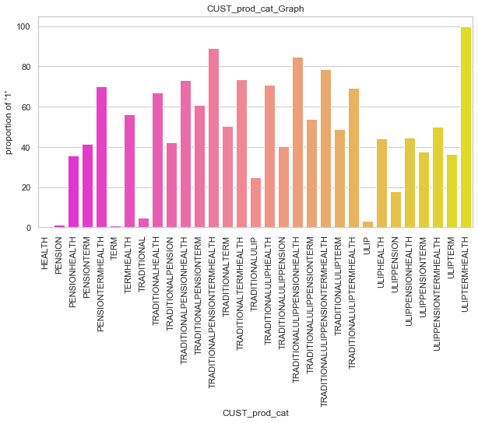
Customer Product Category (significant)
Notes:
Hover around this

Slide 17
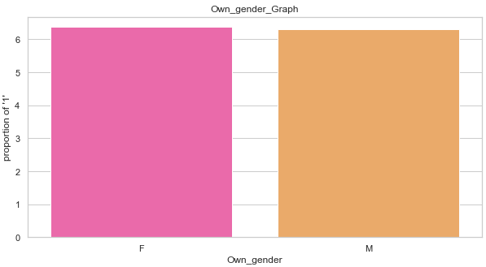
Gender-wise classification (insignificant)
Notes:
-For this categorical variable here, the bar lengths for the gender categories male and female doesn’t show much difference
-We can see the two categories hv almost same proportion of people buying multiple policies
-Thus, this knwing whether a person is male or female doesn’t add anything to my understanding on whether a person will buy multiple policy, making this variable insignificant

Slide 18
Summary of EDA
Sr. No. | Variable Category | No. of Variables | Variable Name | Impact on Target Variable
1 | Amount | 4 | Owner_Salary, afyp, premium, sum_assured | Significant
2 | Gender | 2 | Own_gender, LA_gender | Low
3 | Education | 1 | Own_Edu | Moderate
4 | Occupation | 3 | Occ_Profile, Occupation_Group, Occupation | Significant
5 | Internal Categorization | 2 | risk_status, contract_type | Moderate
6 | Product | 5 | Product_Description, Par_NonPar, Product_brief_Category, Product_Club_Manual, CUST_prod_cat | Significant
7 | Location | 5 | city, DSTNAME, STATNAME, Focus_region, City_classification | Significant
8 | Time | 4 | Age, PPT, Policy_term, billing_frequency | Significant
9 | Flags | 3 | channel_flag, Med_Flag, ECS_flag | Moderate
10 | Marital Status | 1 | Martial_status | Moderate
11 | Identifiers | 2 | policy_number, policy_owner_number | NA
12 | Date | 1 | RCD | NA
13 | Frequency | 2 | Freq, Target | NA
Notes:
-After running this analysis for all variables, we compile a summary of the same
-As you can see, we grouped different variables together, according to the characteristic they expand upon
-Like seen in the graphs, Amounts like Owner_salary, afyp show significant impact nd thus are important features
-while those of gender whether of the proposer or the person covered doesn’t add any value to our understanding nd hence are deemed insignificant
-This classification is used as a reference to verify feature importances in data modelling, coming up next

Slide 19

Model Building
Notes:
-This part deals with the actual model building using a select ML technique
-what features are included
-nd how we interpret different metrics like accuracy, ROC plots, etc to assess and tune our model

Slide 20





Random Forest Model
Iteration 1:
Verify Feature Importance
Iteration 2:
Checking the Metrics
Iteration 3:
Fine Tuning
Steps:
Feature Engineering
Verifying important variables from iteration 1
Checking metrics after choosing important variables from iteration 2
Fine tuning the model in iteration 3
Notes:
-The end goal of our model is to classify whether a person buys additional policy or not, i.e., target = 0 or 1
-To tackle a binary classification problem like this, we use the RandomForestClassifer model
-Known for giving a high accuracy without overfitting a data, we run 3 iterations of this model to get our desired results as shown

Slide 21
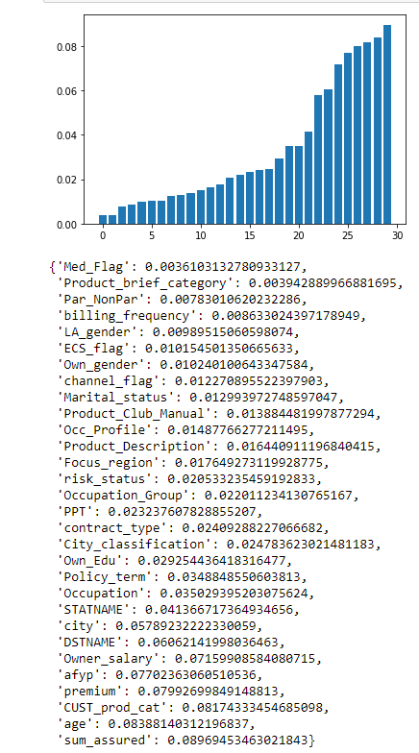
Iteration 1: Feature Importance
Feature engineering:
Label encode categorical variables
Feature Importance:
Selecting features greater than or close to 0.05 for further iteration
Features used
30 (including target)
Accuracy
93.92%
Notes:
-The first iteration used is to decide on the earlier features
-Now earlier we explained during the Exploratory data analysis or EDA part, how features impacted our target variable
-We thus use that to support the results got from fitting the model, and checking feature importances.
-Performing label encoding for categorical variables, we split our dataset into training and validation sets in a proportion of 80/20
-All features as explained in the dataset creation part are included and the visualization here shows feature importances of different variables
-I dnt know if it’s visible but as seen, amounts like sum_assured right at the bottom shows high feature importance, while gender variable can be seen at the top, just like our EDA results showed us
-After verifying these results, we select a threshold value for getting important features, 0.05 nd select all features close to it for further iteration
-I would like you to note the accuracy here, at the first iteration, we’ll see how this is affected later on

Slide 22
Iteration 2: Fitting the Model
 | Predicted
Actual | 0 | 1
0 | True Negative (94.47%) | False Positive (44.16%)
1 | False Negative (5.53%) | True Positive (55.84%)
Features selected: 16 (including target)
Accuracy on validation data:
93.88%
Confusion Matrix: We are fine with false positives, but false negatives impact us more → resources spent will not be useful for these percentage of customers
Notes:
-About half the number of features, with practically no change in accuracy.
-Data generation and storage costs can be reduced. We only need these select features for our model.
-Confusion matrix, we are loosing out revenue on the percentage of customers classified as False Negatives
-In out next iteration, we thus try to get this number below a reasonable value, which will be something specified by the business,..

Slide 23
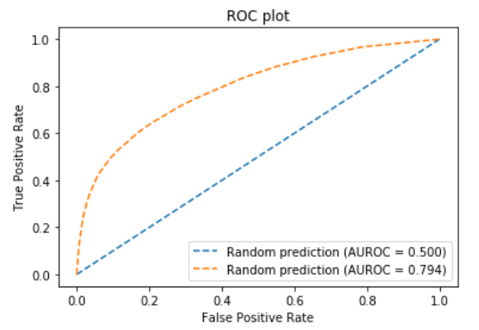
Iteration 2: ROC Plot
AUC : 0.792
As observed from the graph,
the bend is visible between the range 0.3 to 0.5
Notes:
-In order to get some idea of the threshold, as well as to see how good the fit is with regards to a random prediction, we plotted the ROC
-We see that the True Positive Rate starts decreasing faster than the false positive rate when TPR is somewhere close to 0.5
-Thus below this point, more values are categorized as 1’s than 0’s, lowering the false negative rate
-Accordingly we choose a threshold close to this value, trying to get best of both: desired false negative rate and accuracy

Slide 24
Iteration 3: Fine Tuning the Model
 | Predicted
Actual | 0 | 1
0 | True Negative (95.01%) | False Positive (51.24%)
1 | False Negative (4.99%) | True Positive (48.76%)
Accuracy on Testing Data : 93.63%
Threshold = 0.40
We changed the Threshold to get the False Negatives below 5% assuming the same would be tolerated by Business Team
Notes:
-So by choosing a threshold of 0.4, we successfully get our desired output in the third iteration
-We therefore use this iteration as the final model to be used for business
-This addresses the part 1 of our problem

Slide 25
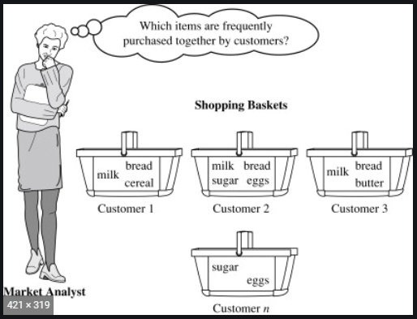
Market Basket Analysis
Notes:
-Now that the model is built, if I say get a list of new customers and their corresponding data, I can figure out whether they’ll be buying additional policies
-But what we are unaware of yet, is which policy will they buy
-Reiterating one of the main aspects of the business, there is a wide gamut of insurance products a customer may choose from
-In order to recommend the best policy to the customer, Market Basket Analysis is used.

Slide 26
Dataset for MBA: Concept
Customer | Policy Bought
Customer 1 | A
Customer 1 | C
Customer 2 | A
Customer 2 | D
Customer 3 | A
Customer 3 | D
Customer 3 | C
Amongst people buying multiple policies, majority buy D as a second policy
Apriori generates such Association Rules (A → D)
Notes:
-To explain the concept of MBA, again say we have a customer 1, buying policies A and C in that order
-Another customer 2 buying policies A, D and third one buying policies A,D and C
-We see that for 2 out of these 3 customers, if the first policy bought is A, then the second policy bought is D
-Thus, we can say that people buying first policy as A have a tendency to buy D as the second policy
-A similar analysis can be done for the third, fourth and other consecutive policies of a customer beyond the policy D
-Though performing this manually for a large dataset is unfeasible, Apriori helps with that. (mlxtend library)
-Generating what we call as ‘Association Rules’ among products bought by customers, we recommend the second policy to a customer
-One important point to note is that here we only use records belonging to customers who have chosen multiple policies (target == 1). Also, details pertaining every policy bought by the customer are included, not just the first one as in the earlier dataset
-We will now take you through the execution of the analysis

Slide 27
Dataset for MBA: Execution
We use all records of individual policies pertaining to a customer
In above figure, each row indicates a customer buying multiple policies; policies chosen form the individual columns
We noted whether a customer buys a policy (listed as 1, 0 otherwise)
Notes:
-First apriori needs the dataset to be in a particular form
-As can be seen above, every record corresponds to a particular customer (policy_owner_number), we have 42 - 43000 customers
and each column shows the different products available
-For our dataset, out of the 5 product related variables, we will be using Product_Club_Manual, since it gave the best detailed categorization of different products
-the data points have values 1 or 0, showing if that particular product (column) is bought by a customer (row) or not
-Once we get data in this form, we feed to apriori and interpret the results

Slide 28
Association Rules: Application
Apriori generates rules which can be summarized as shown in table below
Displaying rules for few Top (71%) categories (Variable: Product_Club_Manual)
Depending on needs of the Business, more rules can be generated
Metric 'Lift': determines how likely the recommended product will be purchased, given the product already purchased
Lift value = 1 | No relation between Product A and B
Lift value > 1 | Product B is likely to be bought
Lift value < 1 | Product B is likely to be avoided
Notes:
-This a summary of the results generated in the orange shaded table
-Product A is the product already bought by a customer, Product B is what the analysis recommends.
-The metric which is called lift tells us how likely the recommended product is bought, interpretation of values for which is present in the adjacent table
-This completes addressing part 2 of the problem statement and solution, nd hence the complete analysis

Slide 29
Conclusion
Random Forest Model helped us to predict -
'Which Customer would buy an additional policy’ with an accuracy of 93.63%
Apriori Model (Market Basket Analysis) helped us find the trend of -
'Which policy the Customers would likely buy as their next policy during cross-selling'
Notes:
-We thus successfully determined whether a person will buy additional policy or not
-And we determined which policy will be best to recommend such a person using the stated techniques
-While this summarizes our project and all our efforts, one of the phases we don’t address is the ‘Model Deployment’ phase
-Businesses in real time continuously evaluate the model built, and modify, overhaul, sometimes completely change the models engineered
-The evaluation is done by checking the actual numbers and comparing them with the predicted numbers, checking the effectiveness of the model, and of course it’s impact on the bottom line
-Given the limited resources, and with our comprehension of data analysis, we have tried the address the problem statement to our best with the given phases, nd will end our project scope at the same.
-We would like to thank IIM Indore and Jigsaw for this opportunity, nd especially our mentor Mr. Gunvant Saini for his insightful guidance on the same.
-Thank you, have a good day

Slide 30
Thank You

